Slide 1
Visual Representation
10

Slide 2
Contents
Modeling the requirements
Data flow diagrams (DFDs)
Process flow diagrams
Entity-relationship diagrams (ERDs)

Slide 3
Visual representations of the requirements
No single view of the requirements provides a complete understanding.
You need a combination of textual and visual requirements representations at different levels of abstraction to paint a full picture of the intended system.
Diagrams communicate certain types of information more efficiently than text can.
Pictures help bridge language and vocabulary barriers among team members.
There are many different diagrams and modeling techniques to choose from to create visual representations of the requirements.

Slide 4
Modeling the requirements
BAs hope to find one technique that pulls everything together into a full representation of a system’s requirements
Unfortunately, there is no such all-encompassing diagram
In fact, if you could model the entire system in a single diagram, that diagram would be just as unusable as a long list of requirements on its own.
Visual requirements models can help you identify missing, unnecessary, and inconsistent requirements.

Slide 5
Visual requirements models
Visual requirements models include:
Data flow diagrams (DFDs)
Process flow diagrams
State-transition diagrams (STDs) and state tables
Dialog maps
Decision tables and decision trees
Event-response tables
Feature trees
Use case diagrams
Activity diagrams
Entity-relationship diagrams (ERDs)
These models are useful for elaborating and exploring the requirements, as well as for designing software solutions

Slide 6
Visual models
A team usually does not need to create a complete set of analysis models for an entire system.
Focus your modeling on the most complex and riskiest portions of the system and on those portions most subject to ambiguity or uncertainty.
Safety-critical, security-critical, and mission-critical system elements are good candidates for modeling because the impact of defects in those areas is so severe.
Also choose models to use together to help ensure all of the models are complete.
For example, examining the data objects in a DFD can uncover missing entities in an ERD.

Slide 7
Selecting the right representations
Information depicted | Representation techniques
System external interfaces | The context diagram and use case diagram identify objects outside the system that connect to it. The context diagram and data flow diagrams illustrate the system inputs and outputs at a high level of abstraction.
Business process flow | A top-level data flow diagram represents how a business process handles data at a high level of abstraction. Swimlane diagrams show the roles that participate in executing the various steps in a business process flow.
Data definitions and data object relationships | The entity-relationship diagram shows the logical relationships between data objects (entities). Class diagrams show the logical connections between object classes and the data associated with them.
System and object states | State-transition diagrams and state tables represent a high-abstraction view of the possible states of a system or object and the changes between states that can take place under certain circumstances. These models are helpful when multiple use cases can manipulate (and change the state of) certain objects.

Slide 8
Selecting the right representations
Information depicted | Representation techniques
Complex logic | A decision tree shows the possible outcomes from a set of related decisions or conditions
User interfaces | The dialog map provides a high-level view of a proposed or actual user interface, showing the various display elements and possible navigation pathways between them.
User task descriptions | User stories, scenarios, and use case specifications describe user tasks in various levels of detail.
Nonfunctional requirements (quality attributes, constraints) | Quality attributes and constraints are usually written in the form of natural language text, but that often results in a lack of precision and completeness.

Slide 9
Data flow diagrams
A Data Flow Diagram (DFD) is a traditional way to visualize the information flows within a system.
It shows how information enters and leaves the system, what changes the information and where information is stored.
The purpose of a DFD is to show the scope and boundaries of a system as a whole.
A DFD identifies the transformational processes of a system, the collections (stores) of data or physical materials that the system manipulates, and the flows of data or material between processes, stores, and the outside world.
DFD levels are numbered 0, 1 or 2, and occasionally go to even Level 3 or beyond.
The necessary level of detail depends on the scope of what you are trying to accomplish.

Slide 10
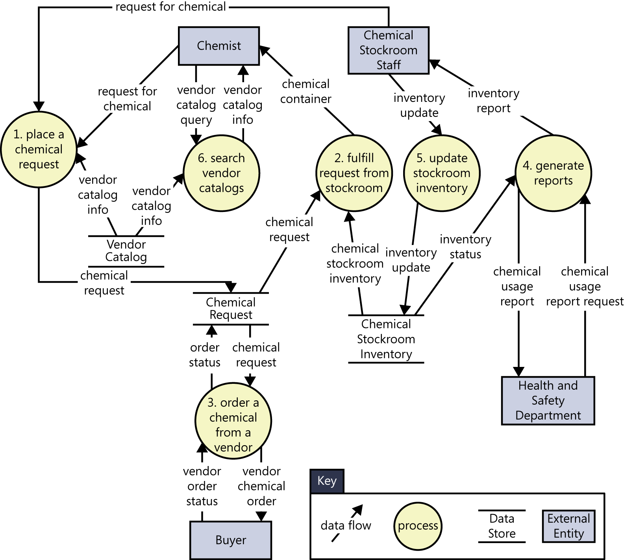
Data flow diagrams
DFD Level 0 is highest level DFD
It’s a basic overview of the whole system or process being analyzed or modeled.
You can elaborate the context diagram into a level 0 DFD
DFD Level 1 provides a more detailed breakout of pieces of the Context Level Diagram.
DFDs could go beyond level 3, but they rarely do.
Level 3 data flow diagrams are detailed enough that it doesn’t usually make sense to break them down further.
Symbols used in DFD:

Slide 11
Partial level 0 data flow diagram for the Chemical Tracking System
A chemist or a member of the chemical stockroom staff can place a request for one or more chemicals if the user is an authorized requester. The request can be fulfilled either by delivering a container of the chemical that is already in the chemical stockroom’s inventory or by placing an order for a new container of the chemical with an outside vendor. If the chemical is hazardous, the chemical can be delivered only if the user is trained. The person placing the request must be able to search vendor catalogs online for specific chemicals while preparing his request. The system needs to track the status of every chemical request from the time it is prepared until the request is either fulfilled or canceled. It also needs to track the history of every chemical container from the time it is received at the company until it is fully consumed or disposed of.

Slide 12
Swimlane diagrams
Swimlane diagrams provide a way to represent the steps involved in a business process or the operations of a proposed software system.
They are a variation of flowcharts, subdivided into visual subcomponents called lanes. The lanes can represent different systems or actors that execute the steps in the process.
They are similar to UML activity diagrams.
sometimes called cross-functional diagrams.

Slide 13
Swimlane diagram
Swimlane diagrams can contain additional shapes, but the most commonly used elements are:
Process steps, shown as rectangles.
Transitions between process steps, shown as arrows connecting pairs of rectangles.
Decisions, shown as diamonds with multiple branches leaving each diamond.
Swimlanes to subdivide the process, shown as horizontal or vertical lines on the page. The lanes are most commonly roles, departments, or systems. They show who or what is executing the steps in a given lane.

Slide 14
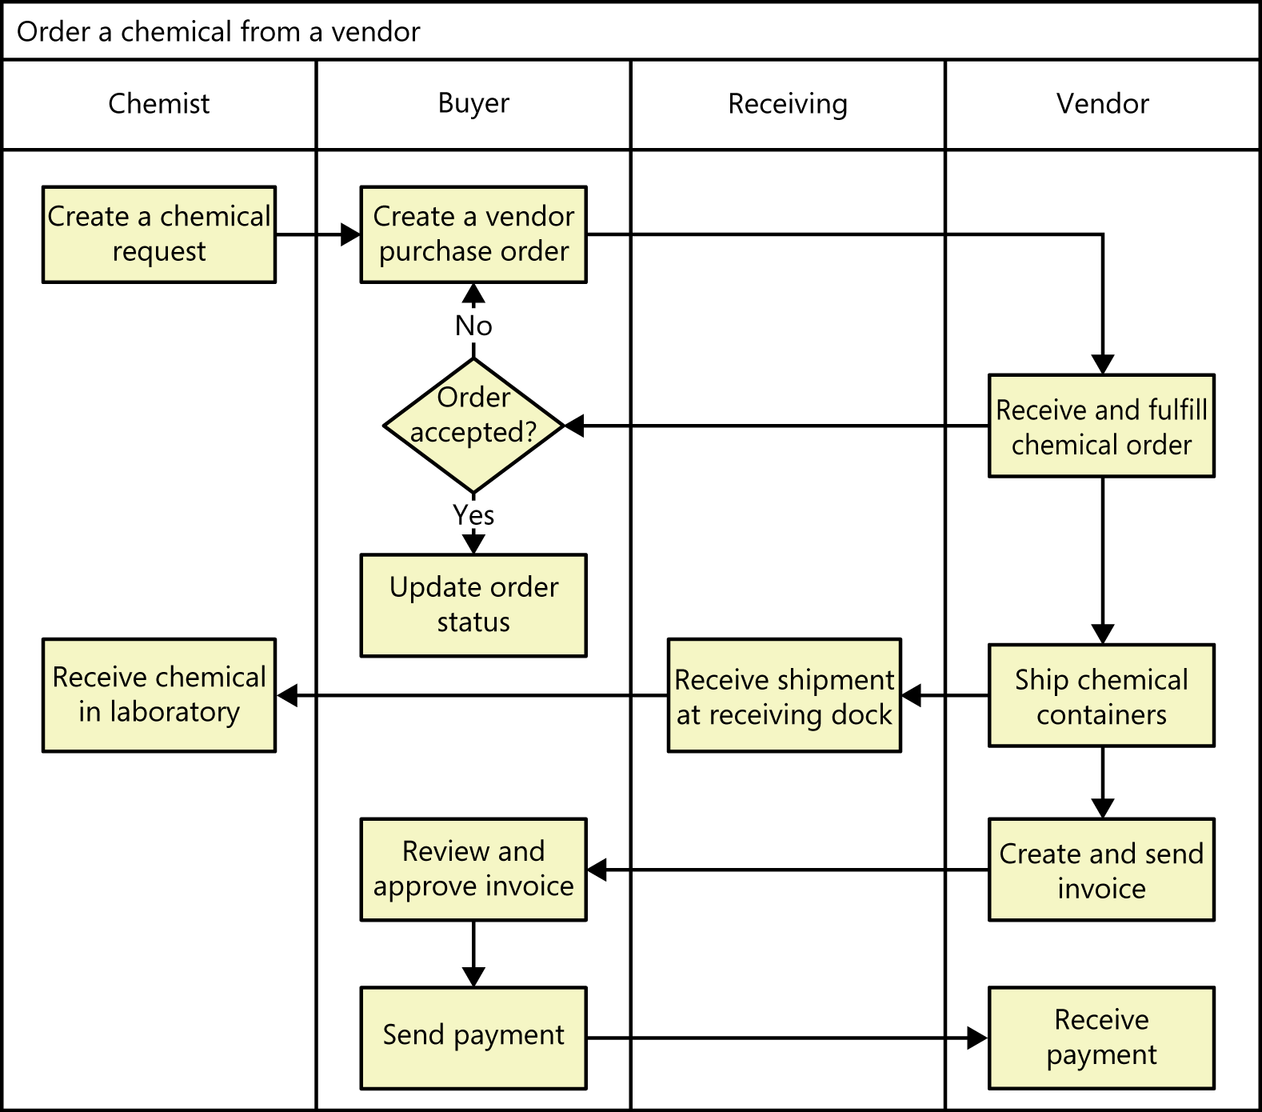
Partial swimlane diagram for a process in the Chemical Tracking System

Slide 15
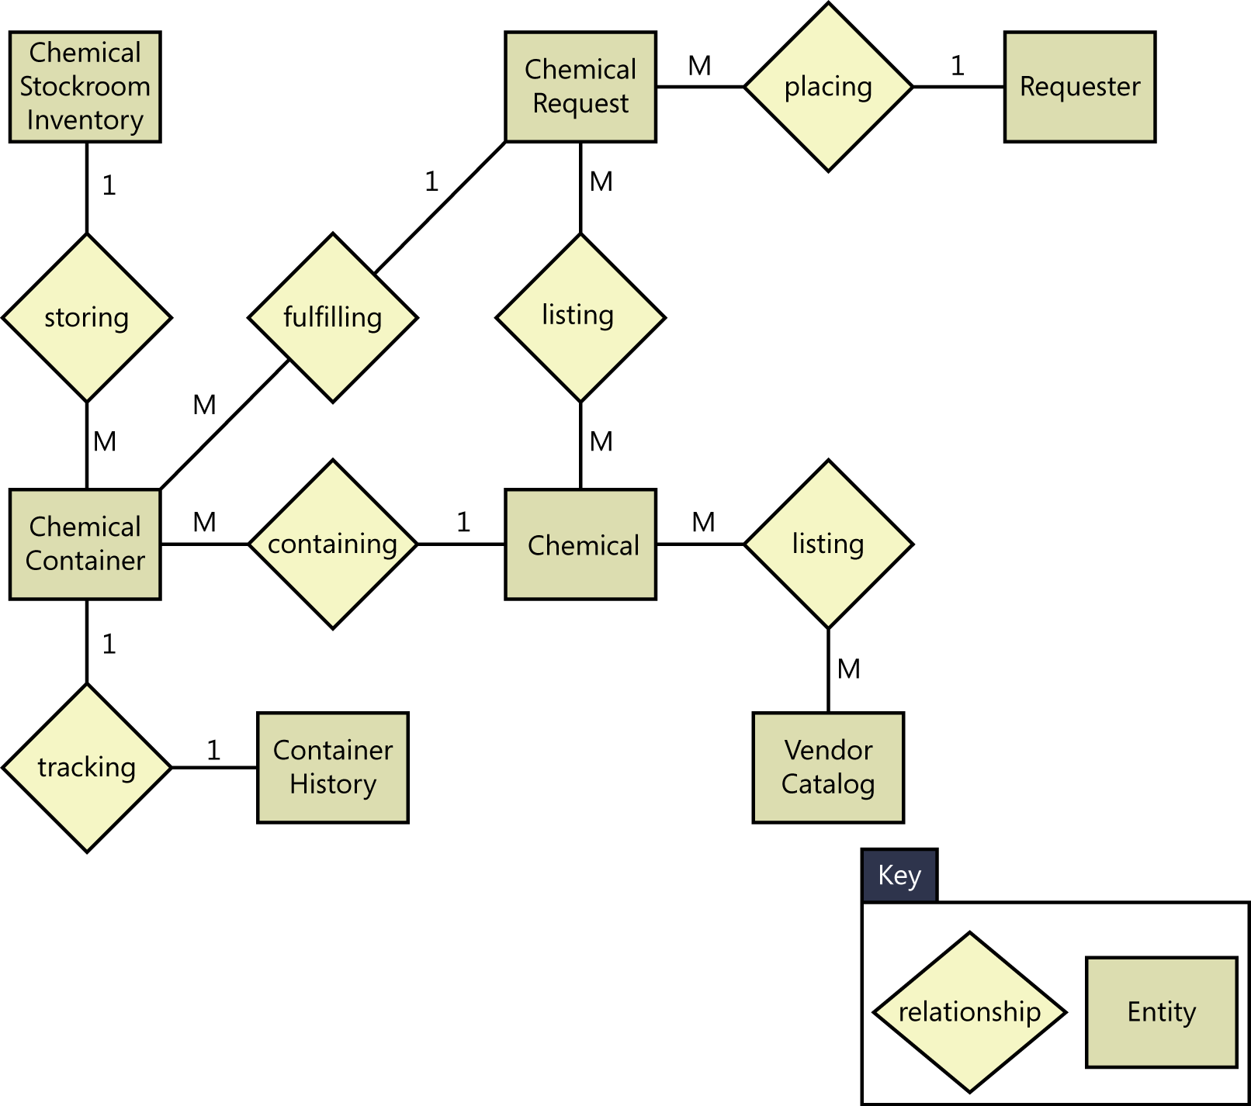
Entity-relationship diagrams (ERDs)
An entity relationship diagram (ERD) shows the relationships of entity sets stored in a database.
An entity in this context is an object, a component of data. An entity set is a collection of similar entities. These entities can have attributes that define its properties.
An entity is an object or component of data. An entity is represented as rectangle in an ER diagram. Entities could represent physical items (including people) or collections of data that are important to the business you’re analyzing or to the system you intend to build.
Symbols used in ERDs:

Slide 16
Partial entity-relationship diagram for the Chemical Tracking System

Slide 17
Requirements to analysis model components
BA can pick out keywords from requirements that translate into specific model elements

Slide 18
Summary
Modeling the requirements
Data flow diagrams (DFDs)
Process flow diagrams
Entity-relationship diagrams (ERDs)

